Slide 1
Kubernetes

Slide 2
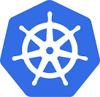
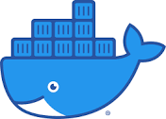
Kubernetes and Container Orchestration
Kubernetes
Container
Container
Container
Application
Application
Application
Frameworks
Frameworks
Frameworks
Libraries
Libraries
Libraries
Docker
Operating System
Hardware

Slide 3
Why Container Orchestration?
Requirement: We want 10 instances of Microservice A container, 15 instances of Microservice B container and ....
Typical Features:
Auto Scaling - Scale containers based on demand
Service Discovery - Help microservices find one another
Load Balancer - Distribute load among multiple instances of a microservice
Self Healing - Do health checks and replace failing instances
Zero Downtime Deployments - Release new versions without downtime

Slide 4
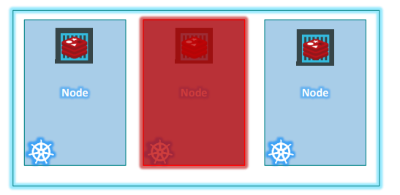
Kubernetes Cluster
Generally has one master node and one or more worker nodes, but may also have multiple master nodes.
Even if one node fails, the other takes over.
Also helps in load balancing.

Slide 5
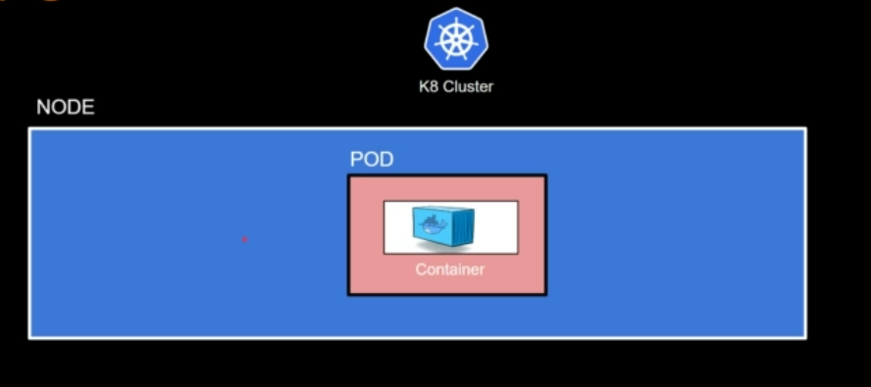
Pod Concept
Kubernetes does not deploy containers directly on the worker nodes.
A container is encapsulated into a Kubernetes object called as Pod.
Pod = A Single instance of an application
A Pod is the smallest object that we can create in Kubernetes.
Remember NPC – Node contains Pod contains Container

Slide 6
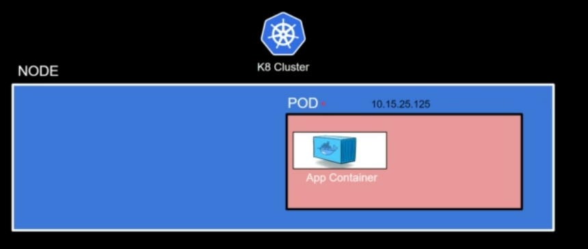
Each Pod has a unique IP address

Slide 7
Kubernetes Objects
Pod: A container with IP address
Replicaset: A group of identical pods
Deployment: Ensures the desired state and scale are maintained
Service: Works with a set of pods and directs traffic to them

Slide 8
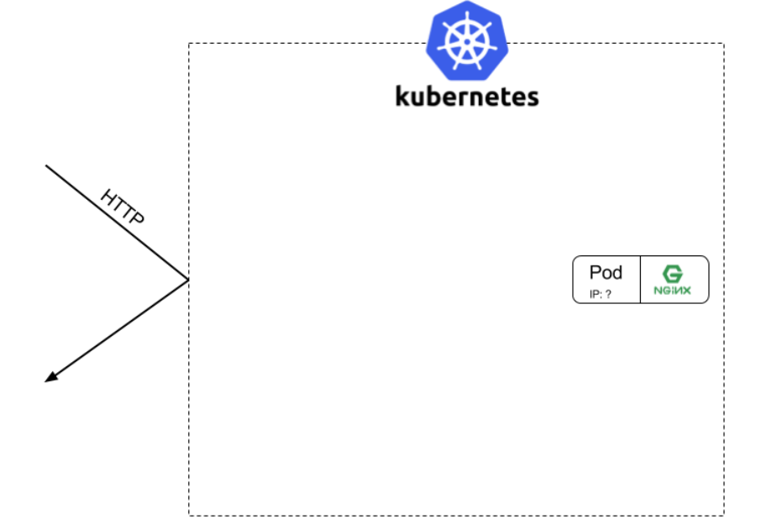
Kubernetes Objects – Pod
A pod is created around ngnix container

Slide 9
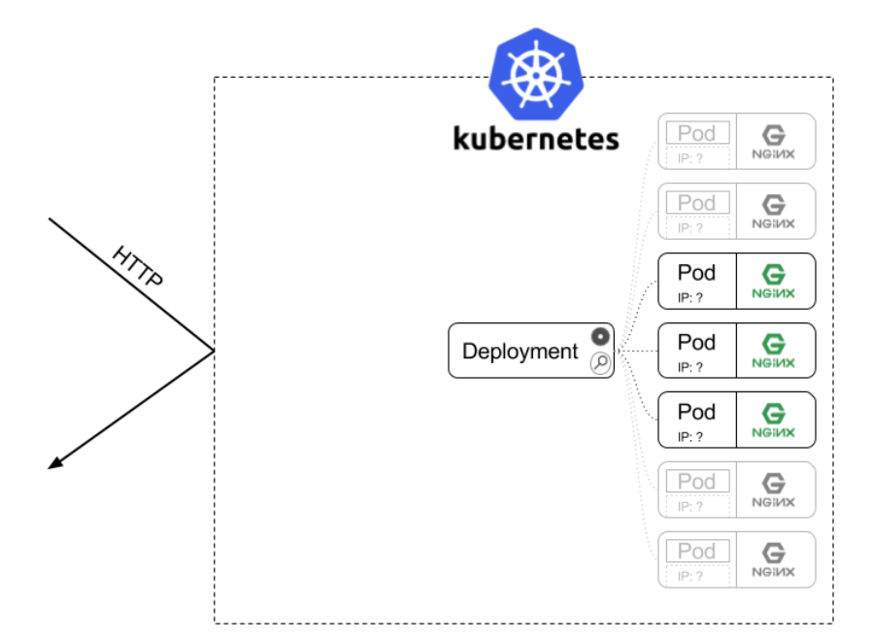
Kubernetes Objects – Deployment
We want it to be scalable, so we create 10 instances using a replica set specified inside a deployment

Slide 10
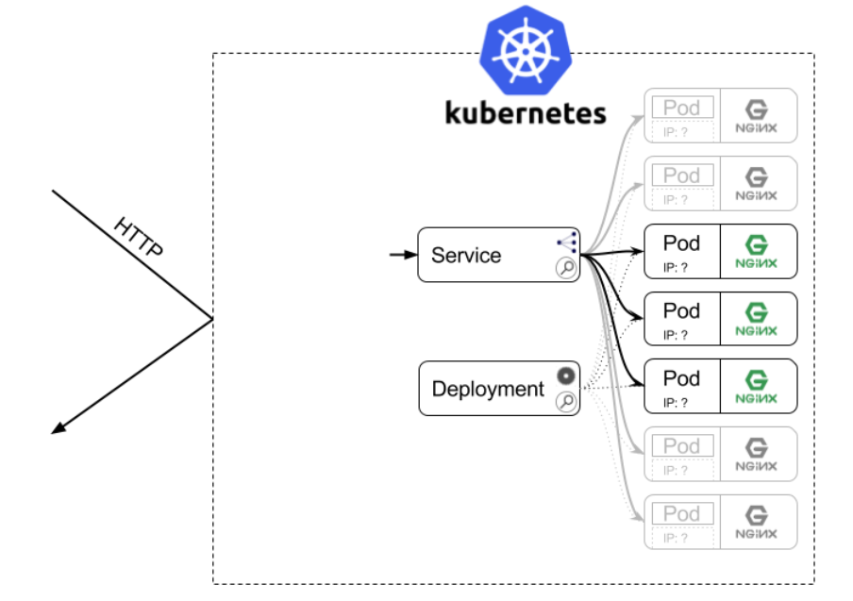
Kubernetes Objects – Service
A service will create a load balancer with an IP address, so that that outside world can access our pods

Slide 11
Kubernetes Installation
Cluster options
Windows: Enable Kubernetes in Docker Desktop
Linux: Use Microk8s, since Minikube gives problems (https://microk8s.io/)
Command line
The kubectl utility (https://kubernetes.io/docs/tasks/tools/)

Slide 12
Linux Installation (Ubuntu 22.04 LTS)
Here, we will install Microk8s, a compact Kubernetes engine
Pre-requisite: Docker
Download and install: https://microk8s.io/
Install microk8s (Lightweight Kubernetes)
sudo snap install microk8s --classic --channel=1.28
Join the group
sudo usermod -a -G microk8s $USER
sudo chown -f -R $USER ~/.kube

Slide 13
Linux Installation (Ubuntu 22.04 LTS)
Reenter the session for the group update to take place
su - $USER
Check status
microk8s status --wait-ready
View node
microk8s kubectl get nodes
View services
microk8s kubectl get services

Slide 14
Linux Installation (Ubuntu 22.04 LTS)
Create alias, so that we can use kubectl command
alias kubectl='microk8s kubectl'
Now test if kubectl command works
kubectl get nodes

Slide 15
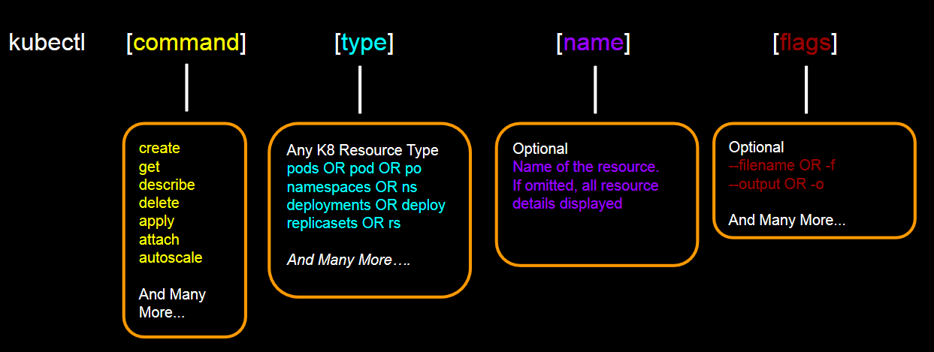
kubectl command

Slide 16
Using Kubernetes

Slide 17
Basic Checks
Is Kubernetes running?
kubectl cluster-info
Check if we have any deployments/pods
kubectl get deployments
kubectl get pods

Slide 18
Creating a Pod
Two options to deploy a pod
Using a kubectl run command
Using a YAML file (inside a deployment)

Slide 19
kubectl run Command
Run a simple nginx server: kubectl run my-nginx --image nginx
Note: In Docker, we may or may not give a name to our container, but in Kubernetes, we must give a name to a pod
kubectl get pods

Slide 20
Creating a Deployment
Deployment is different from pod
Run/create pod command creates a single pod: Generally only for learning, but is not used in real production environment
Instead, we create deployments
Deployment has all the features needed for real-life container use
Creating replicas
Load balancing
Automating on-demand changes

Slide 21
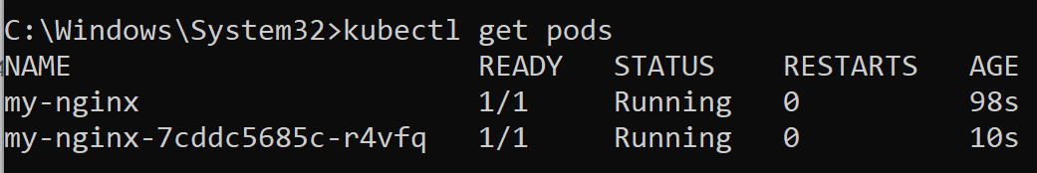
Creating a Deployment
kubectl create deployment my-nginx --image nginx
Now we see two pods:
One standalone pod, created earlier
Second pod created through deployment

Slide 22
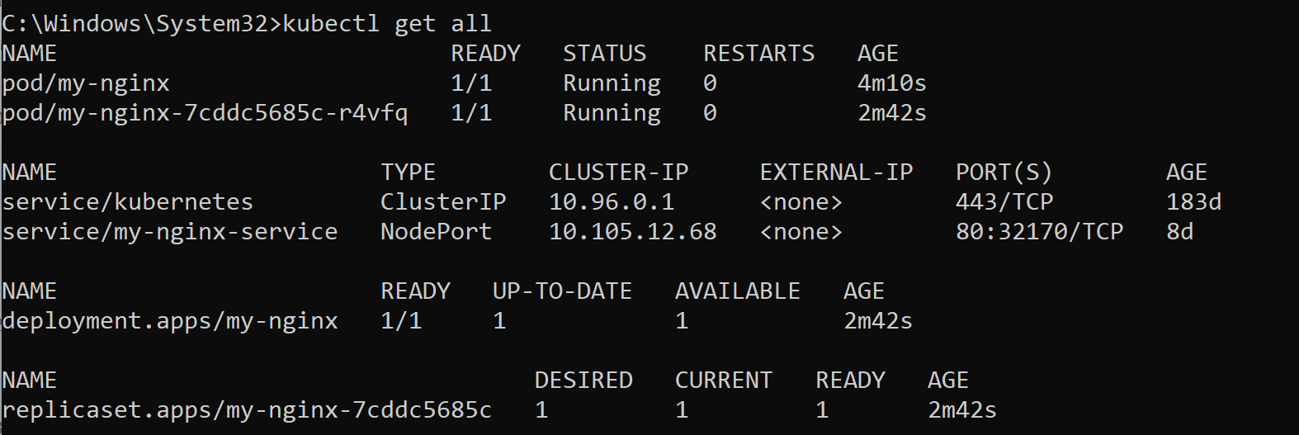
Checking All Resources
Notice that a replicaset for this deployment was automatically created
kubectl get all

Slide 23
Kubernetes Units/Data Structures
Deployment
ReplicaSet allows rolling updates
Example: We are updating our software running on three containers from the old version to a new version
We can have two replicasets
One containing the older pods
The other containing the newer pods
Slowly, the older one dies
ReplicaSet
Pod
Container
Service

Slide 24
Cleaning Up
kubectl delete pod my-nginx
kubectl delete deployment my-nginx

Slide 25
Scaling Replicasets
New deployment with one pod
kubectl create deployment my-apache --image httpd
Scale it up with one more pod
kubectl scale deployment/my-apache --replicas 2
OR kubectl scale deployment my-apache --replicas 2
Here, 2 means we want 2 pods, does not mean add 2 to the existing pods
The scale command does not create a new replica set; instead it modifies the record of the current replica set

Slide 26
Service
A service is a stable address for a pod
A pod on its own does not have an IP address/DNS name etc
A service does that job
The kubectl expose command creates a service for existing pods
Now the pods can be accessed by the clients
Service types
ClusterIP
NodePort
LoadBalancer
ExternalName

Slide 27
Service Types
ClusterIP
Default service type
Available only inside a cluster
Useful when one set of pods need to talk to another set of pods
Single, virtual IP address is allocated
Only reachable from within the cluster
Pods can reach the service on the application’s port number (e.g. If it is Tomcat, port 80)

Slide 28
Service Types
NodePort
Designed for access outside a cluster
High port number (not actual port number of the application) is allocated on each node
Port is open on every node’s IP address
Anyone who can connect to the node can access this

Slide 29
Service Types
LoadBalancer
Generally used in Cloud
Controls a load balancer end point external to the cluster
Only available when we have a load balancer from AWS/Azure/GCP

